Slide 1

Module 2: Matrices
Department of Mathematics Jain Global campus, Jakkasandra Post, Kanakapura Taluk, Ramanagara District -562112
Prof. VEERESH MALAGI
Department of Mathematics,
FET, Jain(Deemed-to-be-University)

Slide 2
Solution of a system of non homogeneous equations:
Linear simultaneous Equations occur in various engineering problems. We are already familiar with the methods, Cramer’s rule and matrix method for solving such equations. But these methods are tedious for large systems.
Here we study now another two methods for solving such large systems.
They are
a) Gauss elimination method
b) Gauss –Seidel method.
Gauss – Elimination Method
In this method, the unknowns are eliminated successively and the system is reduced to an upper triangular system from which the unknowns are found by back substitution.
This method is quite general and is well – adapted for computer operations.
This methods is illustrated by considering a system of three independent equations in three unknowns.
Consider the system of equations
……..(1)

Slide 3
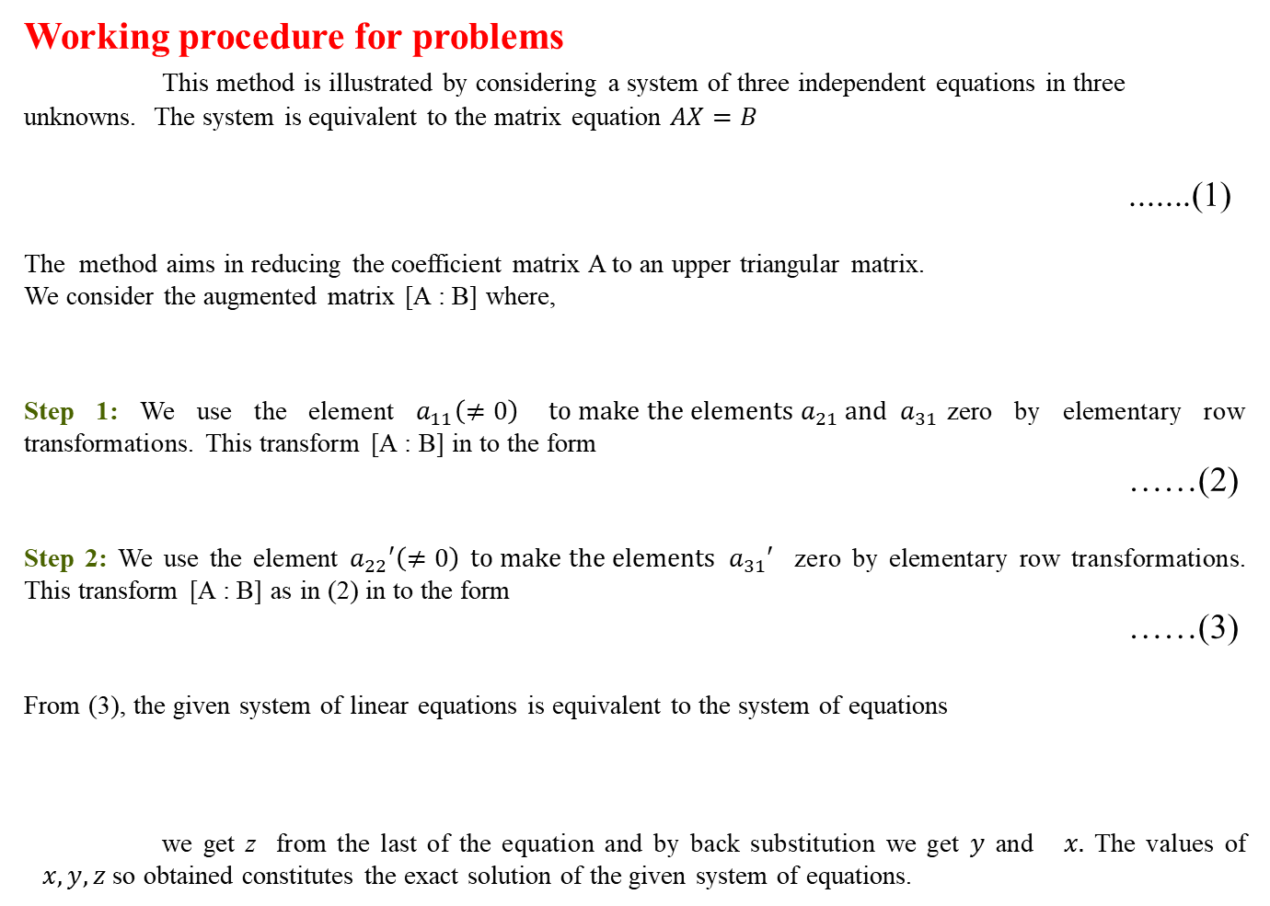
Working procedure for problems
This method is illustrated by considering a system of three independent equations in three unknowns. The system is equivalent to the matrix equation $AX=B$
.......(1)
The method aims in reducing the coefficient matrix A to an upper triangular matrix.
We consider the augmented matrix [A : B] where,
Step 1: We use the element $a_{11}\left(≠0\right)$$to make the elements a_{21} and{ a}_{31}$zero by elementary row transformations. This transform [A : B] in to the form
……(2)
Step 2: We use the element $a_{22}′\left(≠0\right)$$to make the elements { a}_{31}′$ zero by elementary row transformations. This transform [A : B] as in (2) in to the form
……(3)
From (3), the given system of linear equations is equivalent to the system of equations
we get z from the last of the equation and by back substitution we get$y$ and $x.$ The values of $x, y, z$ so obtained constitutes the exact solution of the given system of equations.
Note: In case $a_{11}$or $a_{22}′$ is zero , then its need to re-arrange the equations

Slide 4
Problems
1. Solve the following system of equations by Gauss elimination method.
Hence we have
Solution:
The augmented matrix of the systems is
By back substitution,
The solution is

Slide 5
2. Solve the following system of equations by Gauss elimination method.
Solution:
The augmented matrix of the systems is
Hence we have

Slide 6
3. Solve the following system of equations by Gauss elimination method.
Solution:
The augmented matrix of the systems is
Hence we have

Slide 7
Gauss Seidel Method
This is a numerical iterative method giving approximate solution. This method cannot be applied to all the system of equations.
The method is applicable when the numerically large coefficients are along the leading diagonal of the coefficient matrix .Such a system is called a diagonally dominant system.
Consider the system of equations
……(1)

Slide 8
Working procedure for problems
Step 1: We write equation in the form
Step 2: We write the trial solution (Initial approximation)
Step 3: The first approximations are as follows.

Slide 9
1. Solve the system of equations by Gauss – Seidel method
Solution:
The given system of equations is diagonally dominant and the equations are put in the form
.
Let us start with trial solution
Third iteration:
First iteration:
Second iteration:
Thus,

Slide 10
2. Solve the system of equations by Gauss – Seidel method
Solution:
The given systems of equations are diagonally dominant and the equations are put in the form
Let us start with trial solution
Third iteration:
First iteration:
.
Second iteration:
Thus

Slide 11
Solve the system of equations by Gauss–Seidel method to obtain
the final solution correct to three decimal places
Solution:
The given system of equations is not diagonally dominant and hence we have to first rearrange the given system of equation as follows
Second iteration:
Now the given systems of equations are diagonally dominant and the equations are put in the form
Third iteration:
Let us start with trial solution
First iteration:
Fourth iteration:
Thus

Slide 12
4. Solve the system of equations by Gauss – Seidel method
carryout 4 iterations taking the initial approximation to the solution as (1, 0, 3).
.
Solution:
The given system of equations are diagonally dominant and the equations are put in the form
Let us start with trial solution
Third iteration:
First iteration:
Fourth iteration:
Second iteration:
Thus

Slide 13
Thank You

